Slide 1
Review Sprint 1 PIVOANE PIéton, Vitesse, dOs d’ANE
OUR TEAM
Sara Bassanetti
Emeline Delhay
Achraf Laazizi
Luiz Renato Rodrigues Carneiro
Léa Scheer
Yuchen Xia
TUTORS
Gwendolyne Le Corre
Thierry Monteil
Notes:
Hello,
My name is Luiz Renato …
Our tutors are Gwendolyne Le Corre and Thierry Monteil
This is the presentation of the review 0 with our project plan of the autonomous vehicle project. The name of our project is PIVOANE due to the translation of the words pedestrian, speed, and speed bump in french.

Slide 2







Table of content
Product description
Objectives of Sprint 1
Organization of Sprint 1
Operational Requirements
Stories and demonstration of Sprint 1​
​
Research on Artificial Intelligence​
Schedule control
​
Objectives of the Sprint 2​

Slide 3
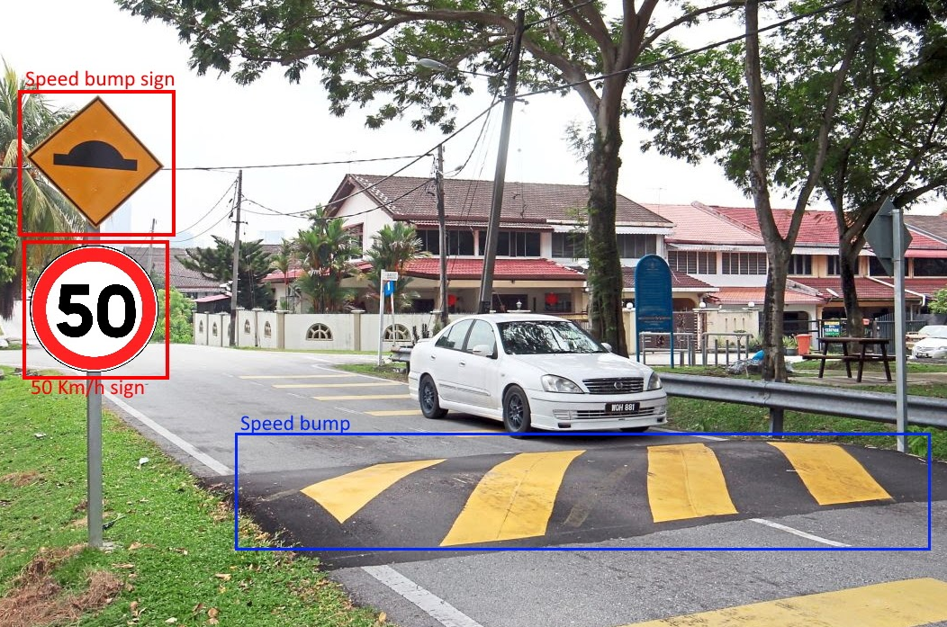

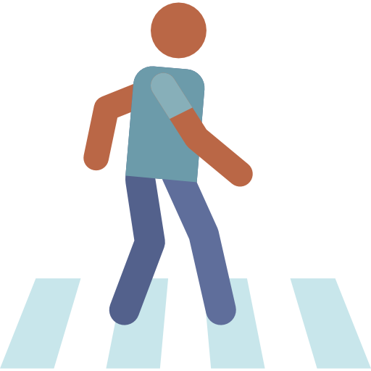
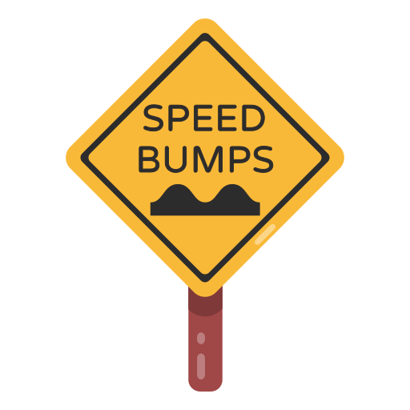
Product description
Adapt the car's behavior according to the environment detected in different complex situations
Adjust the speed of the car when a road sign is detected
Stop the car when there are pedestrians on the road
Slow down when approaching a crosswalk or speed bump

Slide 4



Objectives of sprint 1
Speed control
Control the car’s speed to reach a specified one
Drive on a straight line
Avoid steering angle
Sensors Communication
Communicate with the needed sensors

Slide 5
Organization of Sprint 1
Sprint 1
1st week
2nd week
3rd week
4th week
Speed control
Moving straight
Artificial Intelligence (detection)
Preparatory work
Tutorials (ROS2, NVIDIA)
Sprint objectives

Slide 6

Operational requirements
General behavior
half speed
unmoving
full speed
The car shall:
• Go from full speed to unmoving in less than 1 meter
• Go from full speed to half speed before reaching the speed-limit road sign (50 centimeters)
Notes:
During sprint 0, we presented operational requirements we had extrapolated from a real car. During the first sprint, we started by testing these requirements with our car. The first thing we quickly realized was our car had a fast reaction time. Based on this, we reworked our requirements. We decided the car should be able to go from full speed to unmoving in less than 1 meter, and halves its speed within only 50 centimeters.
The same way, we looked at our different sensors to have an idea of their precision. After looking at the Ultrasonic sensors at the front of the car we decided the car should be able to detect obstacles on a 5 meters radius on the front of car

Slide 7
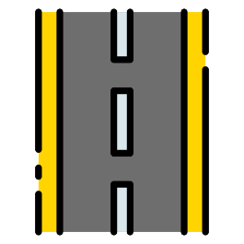


Sprint 1
User Story 1:
The car must keep a straight trajectory
Restrain car drift
Control the motors
Notes:
Our first User Story was for the car to keep a straight trajectory. To do so, we had to learn how ROS2 works and we all studied the online tutorials.
First thing first, we had to communicate with the car wheels. It had been coded previously, and based on it we used an already defined PWM. The main difficulty of this user story was to retrain the car drift.

Slide 8

Sprint 1
Car drift issues
Delay in data reading
Play in the wheels’ mechanism
Test:
Ensure the car can follow a straight trajectory on at least 5 meters
Notes:
Like we were expecting, sending the same PWM to each wheel’s motor didn’t worked because there is a small difference between these motors meaning a wheel is turning slightly faster than the other and creating a drift. To solve this we used a closed loop control system. The first difficulty we encountered while doing this came from the sensors measuring the speed of each wheel. They were updating the value every 100ms and due to the delay our loop had stability issues, meaning the car wheels were turning pretty irregularly. Thanks to Alexis, who changed the communication time with the sensors from 100ms to 5ms, this problem was solved.
However, our car still not following a straight trajectory, even though the wheel speed was pretty regular. We realized there was a small play in the wheel’s mechanism meaning the car wheels were not perfectly aligned, even after calibration, and we have to align them manually and it doesn’t work everytime. Right now, we haven’t completely solved this issue, and we will work on using different sensors, such as the IMU and the GPS, to ensure a straight trajectory later on.

Slide 9


Sprint 1
User Story 2:
The car can accelerate and decelerate until reaching full stop
Control speed between 0 and 2 km/h
Have a smooth acceleration
Calculate response time
Test:
Test the acceleration and deceleration on a straight line
Notes:
Our second user story was for the car to accelerate and decelerate. We first tested the maximum speed of the car, which was around 2km/h, way less than what we expected. We also realised the response time was really fast, like I said earlier. Finally, to have a smooth speed change, we use a ramp at the start so that the car doesn’t directly go from unmoving to full speed for example

Slide 10

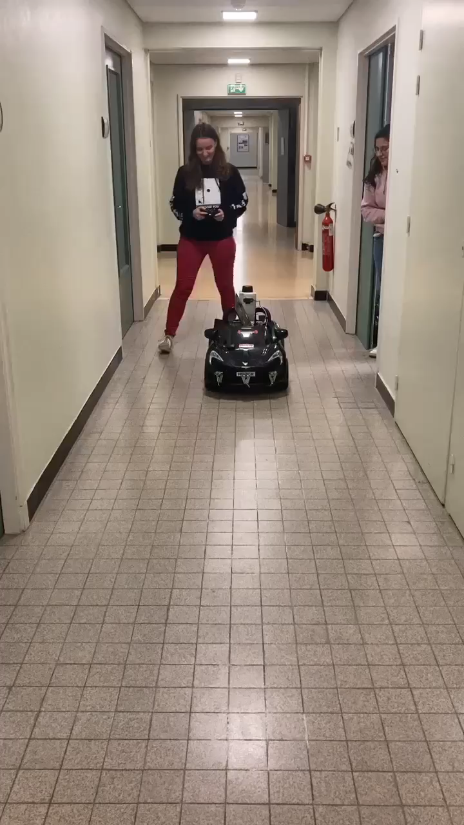
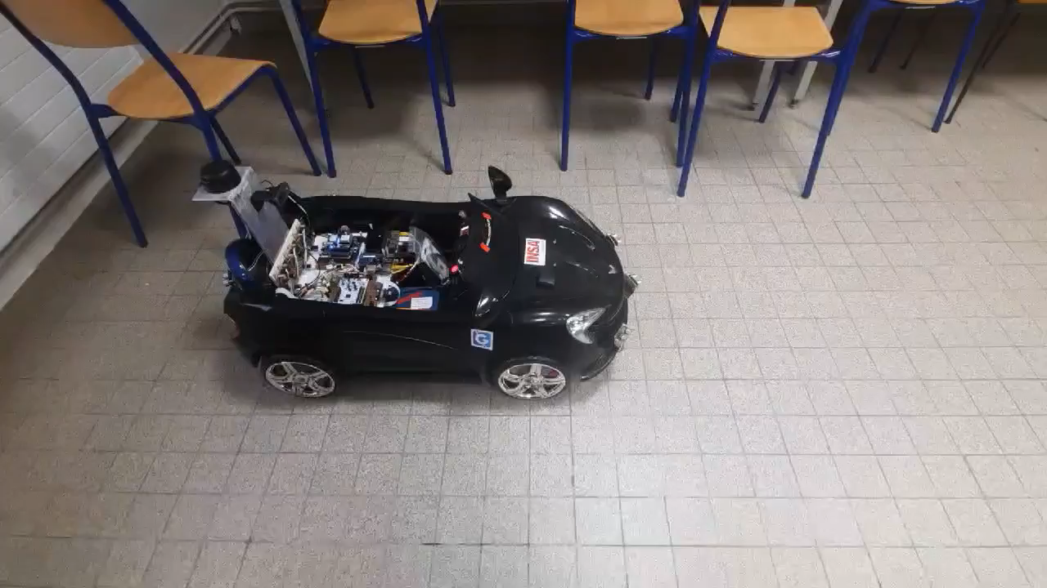
User Stories demo
Notes:
Yuchen

Slide 11

Sprint 1
User Story 3:
The car will read and print the data from some sensors
Read sensors datasheets
Print data
Communicate with the sensors
Test:
Read the feedback data of the inertial measurement unit, motor and ultrasonic
Notes:
Yuchen
Expliquer que c’était rapide et peu complexe
On a verifier que tous nos capteurs marchent
Expliquer qu’on ne pense pas utiliser le Lidar, mais seulement la camera et les ultrasonic sensors pour la detection d’IMU
On utiliseras peut-être l’IMU si on a de vrais dos d’âne

Slide 12
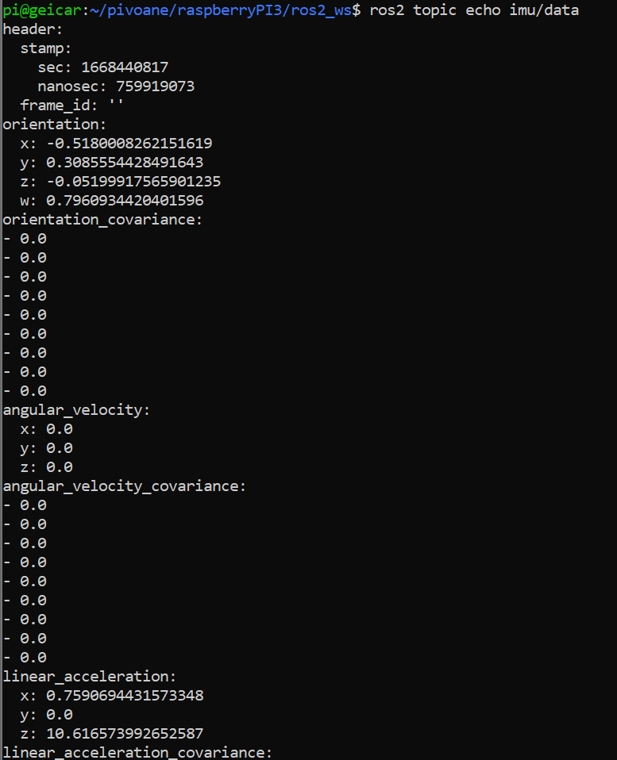
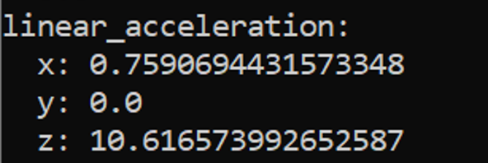
User Story 3 demo
Sensor tests:
Inertial Measurement Unit (IMU)
Notes:
Yuchen
Montrer les différents types de données recus (camera, lidar, ultrasonic sensors, rpm)

Slide 13
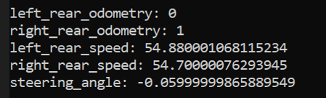
User Story 3 demo
Sensor tests:
Motors_feedback
Notes:
Yuchen
Montrer les différents types de données recus (camera, lidar, ultrasonic sensors, rpm)

Slide 14

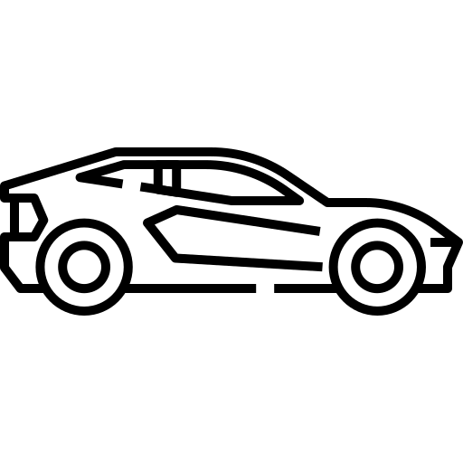

User Story 3 demo
Sensor tests:
Ultrasonic sensors
Notes:
Yuchen
Montrer les différents types de données recus (camera, lidar, ultrasonic sensors, rpm)

Slide 15
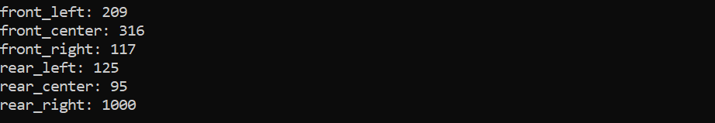
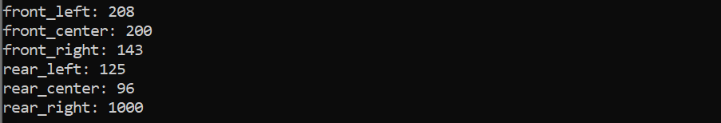
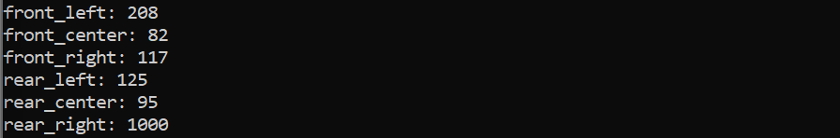
User Story 3 demo
Sensor tests:
Ultrasonic sensors
Notes:
Yuchen
Montrer les différents types de données recus (camera, lidar, ultrasonic sensors, rpm)

Slide 16



Computer Vision
Class of Neural Network:
Convolutional Neural Network (CNN)
Frameworks
Notes:
Luiz

Slide 17
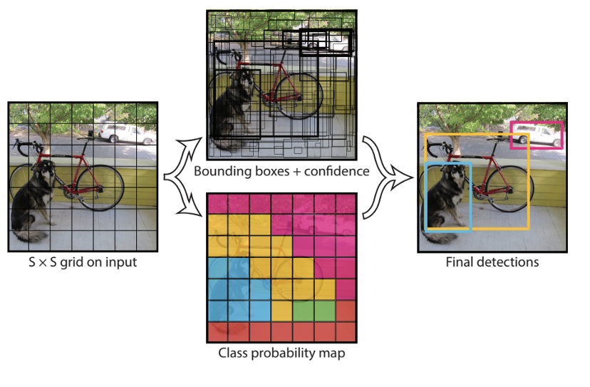
Computer Vision
Object Detection:
Best architecture for real time
Yolo
Notes:
Luiz
Yolo You only look once
One stage, do not have the region proprosal
RCNN Region-Based CNN (RCNN)
Region proposal takes too much time un Faster RCNN

Slide 18
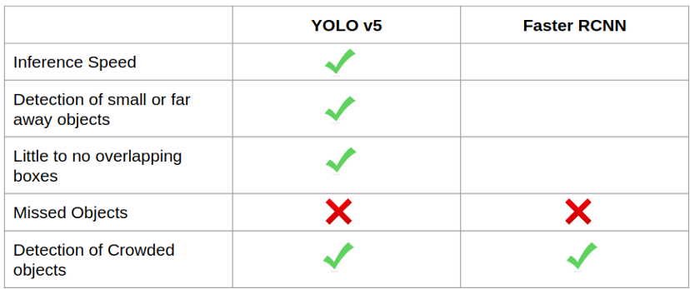
Computer Vision
Object Detection:
Best architecture for real time
Better performance
Notes:
Luiz

Slide 19


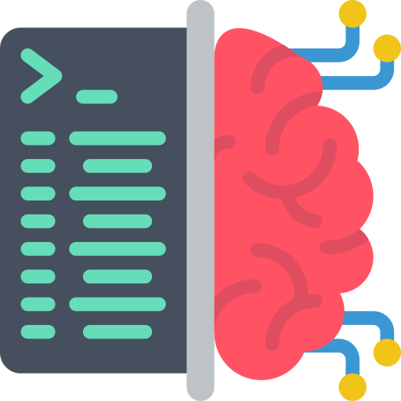

Computer Vision
Docker: Object Detection +ROS in Jetson
Docker
Machine Learning Framework
GPU Acceleration
ROS2 Humble
Notes:
Luiz

Slide 20
AI research
Docker solutions
Docker
NVIDIA-ISAAC-ROS
ML Container Jetson
Many Features
Works well with Jetson
Not compatible with Jetson Nano
Only Pytorch
Only Tensorflow
Only ROS2 Humble
Create our own image
New ML Container Jetson
All features we want
Time consuming
May not work
Pytorch
ROS2 Humble
Notes:
Luiz

Slide 21
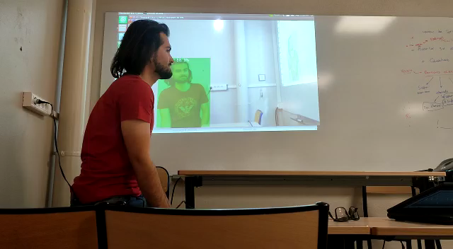
AI research
Jetson Inference using Pytorch Container
Not supported for ROS2
Humble, but is supported
for ROS2 Eloquent
Notes:
Luiz

Slide 22
Schedule Control
Done:
The car drives following a straight trajectory.
The car can accelerate, decelerate and stop.
The data can be read and printed from some sensors.
Planned:
The car drives following a straight trajectory.
The car can accelerate, decelerate and stop.
The data can be read and printed from some sensors.
Not planned:
AI research
Notes:
Yuchen

Slide 23



Objectives of sprint 2
AI training
Create and train the AI model which detects road signs and pedestrians
Road sign detection
Detect and recognize road signs
Obstacles detection
Dectect obstacles on the road
Notes:
The objectives of sprint 2 are focus on detection.
At the end of the sprint the car will be able to detect obstacle on the road with ultrasonic sensors and AI intelligence will detect road sign on the side.
We decide to divide the following weeks into 3 different user story to achieve all theses objectives

Slide 24

Sprint 2
User Story 1:
Detect road signs on the side of the road
Object detection
Create or find dataset
AI training
Test:
Simulate a road sign on the road
Check the printed data
Notes:
The first user story is to be able to detect road sign on the side of the road. To achieve that, we have to build a road sign dataset. We can find dataset already created by someone else or create ourself if we can't find something good enough to use it in our case. This dataset is necessary to train AI intelligence after and recognize road sign. When our AI model will perform as we wanted, we will be able to detect road sign on the side to the road. To simulate that, we will put a road sign on the path of the car and check if the correct data are posted.

Slide 25
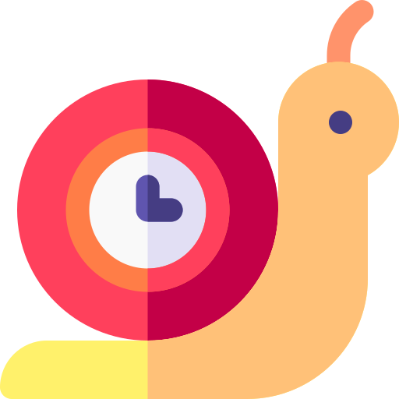
Sprint 2
User Story 2:
Slow down after a road sign is detected
Adapt behavior with environment detection
Speed control
Calculate speed
Calculate response time
Test:
Observe speed change after detection of speed road sign
Notes:
Sara
The second user story is following step. Indeed, we will adapt the behavior of the car with the detection of the road sign. So, when a road sign is detected on the road, we have to manage the speed control of the car. The car will have to pass to full speed in half speed after the detection. We have also to calculate the response time of the car to be sure all the operational requirements are respected. In this case, the car have to slow down completely in less than 2 meters. To simulate, we will test the behavior of the car after the test of detection I explained you on the previous user story. So we will detect a road sign on the side if the road and we will observe the behavior of the car which have to slow down after the detection.

Slide 26
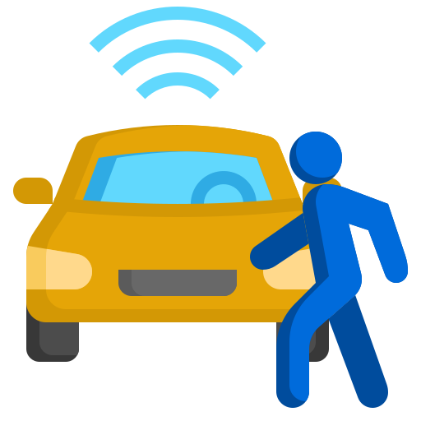
Sprint 2
User Story 3:
Detect obstacles on the road
Read and interpret data from ultrasonic sensors
Stop the car
Calculate speed
Test:
Simulate an obstacle on the road in front of the car
Stop the car
Calculate response time
Notes:
Sara
The last user story will be implement in the same time of the AI detection. Using ultrasonic detection, the car have to detect obstacle on the road. To be able to do that, we will have to read data from these sensors, interpret these and stop the car when an obstacle is detected. We have also to calculate response time to be sure all the operational requirement are respected and to be sure there are no chance for a pedestrian to be hurt by the car. To simulate this user story, we will put one of the team member on the road of the car and observe the behavior of the car which as to stop before to reach the person.
We choose to divid tasks of the sprint in two groups of there. Luiz, Me and Achraf will mork on the AI detection and Lea Emeline and Yuchen on ultrasonic detection.

Slide 27
Organization of Sprint 2
Sprint 2
1st week
2nd week
Road sign detection
Adapt behavior with environment detection
Ultrasonic obstacle detection​
Sprint objectives

Slide 28



Summary
Review Sprint 1: Car automation
Sprint 2: Object detection
Move straight
AI detection
Speed control
Ultrasonic detection
Notes:
To sum up, first sprint was focus on the move automatization of the car. Even if we struggle to move the car in the straight line and we make time to understand how the hardware and software of the car, we can say that we succeed to achieve all of the user story we planed. So we can start the second sprint and focus on the object detection by AI intelligence and ultrasonic sensors.

Slide 29
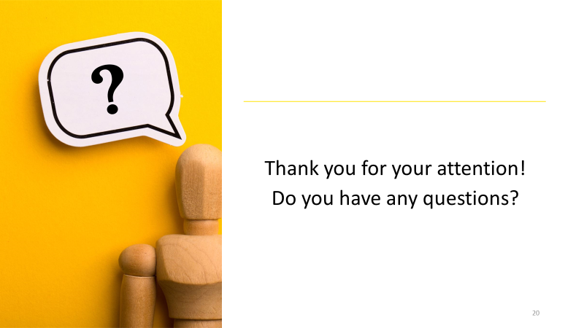
Notes:
Sara
Your opinion of this first sprint.

Slide 30
Sources
www.flaticon.com
https://www.justifit.fr/b/guides/droit-routier/causes-accidents-de-la-route/
https://towardsdatascience.com/r-cnn-fast-r-cnn-faster-r-cnn-yolo-object-detection-algorithms-36d53571365e
https://towardsdatascience.com/yolov5-compared-to-faster-rcnn-who-wins-a771cd6c9fb4

